Slide 1


VA VISTA Data Access
Interoperability Design Review
May 3-4, 2017
Continuity of VA Care
during EHR Modernization
VISTA Data Project
Two-year Proof of Concept
A joint interagency project with the
U.S. Department of Defense, Defense Health Agency
VA-DoD Interagency Project
EHR modernization Proof of Concept
Leverages DoD-developed technology
Formalizes Veterans Care Model
Execution 2016-2017
http://vistadataproject.info

Slide 2


History of VHA-DHA Electronic Health Records
DHCP is the common base system
VHA: 151 hospitals; 820 clinics; 300 vet centers; + other (total 1700 care sites)
DHA: 57 hospitals; 350 clinics + other
VHA: 131 VISTA systems operational (since 1981)
DHA: 101 CHCS systems operational (since 1985)
Total: 232 DHCP-based systems across VHA-DHA
DHCP-based systems
VHA-specific interface and workflow
Common technology projects
DHA-specific interface and workflow
Veterans Health Administration (VHA)
VHA
operational client
CPRS
operational database
and workflow
VISTA (x131)
joint
technology
projects
TAPS
VDP
*
Common
Base
System
DHCP
JLV
iEHR
Defense Health Administration (DHA)
operational database(s)
and workflow
CHCS (x101)
DHA
CDR / MDR
operational client
AHLTA
While DHCP was similar in VHA and DHA originally, it has diverged over time. Today the variety and volume of CHCS data is approximately one-third the scope of VISTA data. One reason for the difference is that DHA migrated a large portion of CHCS operational data and functions to CDR / AHLTA.
1980
1990
2000
2010
present
VHA-specific
VISTA
CPRS
Note: Time scale
simplified for clarity
Common
DHCP
JLV
iEHR
TAPS
VDP
DHA-specific
CHCS
AHLTA / CDR
Genesis
1981 - DHCP - Decentralized Hospital Care Program - VA Fileman database and applications [VHA]
1985 - CHCS - (DHCP renamed) Composite Health Care System; modified for DHA use [Leidos (SAIC)]
1994 - VISTA - (DHCP renamed) Veterans Information Systems Technology Architecture [VHA]
1997 - CPRS - Computerized Patient Record System - graphical interface and workflow [VHA]
2004 - AHLTA/ CDR/ MDR - Armed Forces Health Longitudinal Technology Application [Northrup Grumman]
2003 - JLV - (originally Janus; renamed to JLV in 2011) [DHA-VHA]
2011 - iEHR - Integrated Electronic Health Record [ SMS ]
2013 - TAPS - Transition Application Plan Support [DHA-VHA]
2016 - VDP - VISTA Data Project [DHA-VHA]
*
-
-

Slide 3


DHCP (CHCS/VISTA) servers today
DHA
Common
VHA
Operational
Care Specifics
AHLTA
JLV
CPRS
Clients
read/write
x1
x1
(Look-back)
x131
x131
read/write
operational
clinical data
migrated
CDR
Operational
Data
CHCS x101
DHCP
VISTA x131
operational
reporting data
migrated
MDR
x131
x1
Operational
Reporting
Reports
DHA migrated much of its operational data from CHCS to MDR / CDR .
Today the variety and volume of CHCS data is approximately one-third the scope of VISTA data. One reason is that DHA migrated a large portion of CHCS operational data and functionality to CDR / MDR.
VHA has not decided on its long-term strategy for operational data.
-
3￼
-

Slide 4
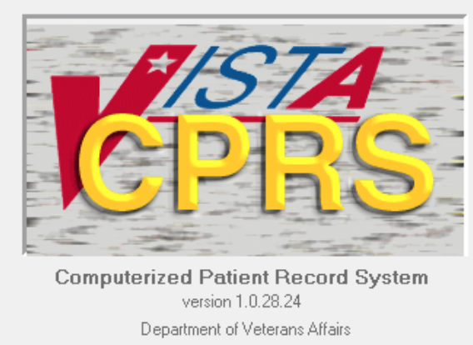
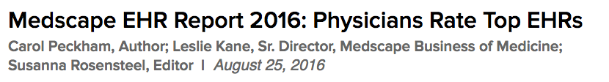
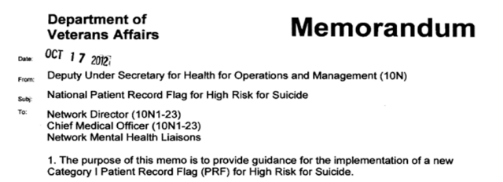
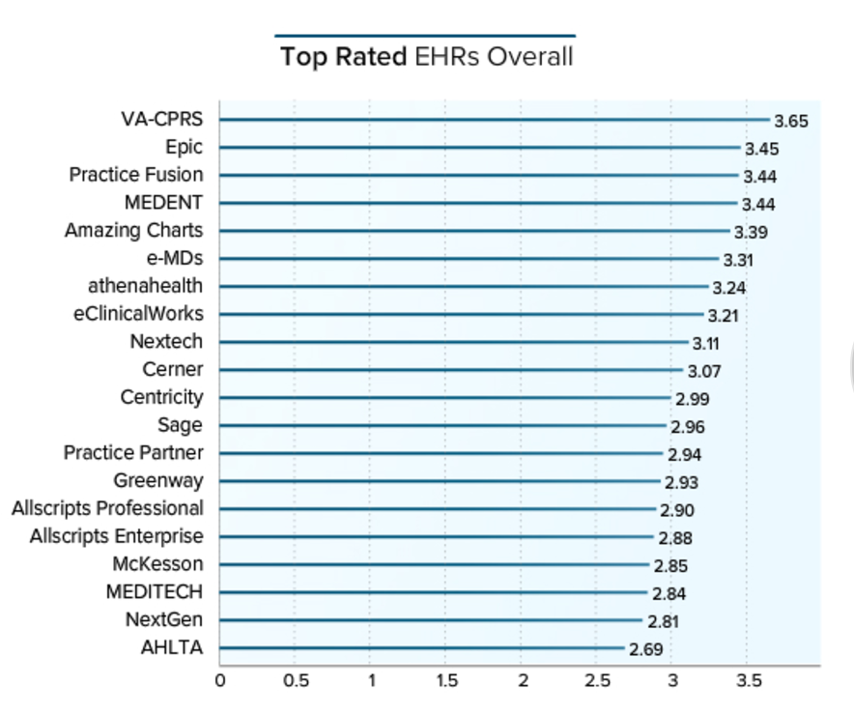
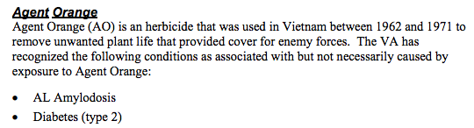
CPRS: Blueprint for Veteran Longitudinal Care
CPRS is VISTA to Physicians, and Embodies Veteran Care specifics
Veteran-specific
Physicians favorite
Built specifically around veteran
care policies and practice
http://www.medscape.com/features/slideshow/public/ehr2016
Opportunity:
Supporting CPRS (for a period) ensures
Continuity of Care as VA’s EHR is modernized.
-
4￼
-

Slide 5
Proof of Concept
VISTA Data Project
https://vistadataproject.info
A modernized VA EHR server can support CPRS
-
-

Slide 6

VISTA Data Project
VISTA Data Project
Key Features
https://vistadataproject.info
VHA-DHA Interagency project
Modernization Proof of Concept
Leverages DHA-developed technology
Formalizes Veterans Care Model
Migrate Server; Support CPRS/JLV
Execution 2016-2017
Prove Stepwise Server Migration
while maintaining Continuity of Care
131 Current VISTAs
VISTA Data Project
CPRS / JLV ….
CPRS / JLV
(current continue)
web/mobile
(new enabled)
Insecure
Asymmetric
Opaque
Legacy MUMPS
Code-driven
Interfaces
Secure
Symmetric
Modern Node.js
Model-driven
Interface
RPC
Interfaces
(x 1000s)
or
or
Stepwise, Measurable Migration
RPC Interfaces (includes VPR)
Pass Thru
RPC Emulator
VPR Emulator
REST
Current
Server
Pass Thru
Emul
Clinical Domain Services
“node
VISTA”
Time
Pass Thru
Emulate
Master VISTA Data Model
Node
VISTA Applications
Pass
Emulate
VISTA Data Model
VA Fileman Database
Emulate/REST
VA Fileman Database
“Magic” MUMPS-driven VISTA Server
(maintenance, growth, and usability issues)
Structured VISTA Server
(mainstream, modular, extensible)
New, maintainable veteran care server based on mainstream technology
New web and mobile clients enabled with mainstream technology
Current clients (CPRS/JLV) supported and enforce VA Care coverage
May now safely incrementally retire legacy MUMPS VISTA [spaghetti]
(Some) Clinical Domain Services may be implemented over COTS
M
Legacy VISTA (MUMPS)
Strategic
Benefits
Master VISTA Data Model (MVDM) Node.js - Driven VISTA

Slide 7
nodeVISTA Stack
Clean, Modular, Separation of Functionality
Emulation and New Interfaces
All reduce to same service interactions
RPC Emulator
VPR Emulator
REST
(Problem, Pharmacy …) Services over MVDM
Patient level selection and security
Clinical Domain Services
Node
Normalizes VDM
Distinguishes Veteran and Patient/Clinical specifics
A Clean “CRUD+R”/Events paradigm
Master VISTA Data Model (MVDM)
Transparent JSON of the native model
Read for 100% data in FileMan
Write Tested for MVDM covered classes
VISTA Data Model (VDM)
All interaction through formal FileMan API
Only FileMan changes fix Data Dictionary (DD)
VA Fileman Database
Structured VISTA Server
(mainstream, modular, extensible)
Javascript/Node.js
-
7￼
-

Slide 8
nodeVISTA Data Access
Starting point is read access to 100% of FileMan-stored data
(including labs) and then extends to transactional data
Read-write
Read
MVDM is a normalized subset of VDM and supports symmetric read-write transactions.
Emulator
VDM provides access to 100% of
native VA Fileman-stored data, all in web-standard JSON.
Clinical Services
extent of
transaction
support (%)
MVDM
VISTA Data Model (VDM)
VA Fileman Data
0
extent of data access (%)
100
-
8￼
-

Slide 9
Backward-compatible Emulation in Steps
All client interactions are captured in regression test suite [“no magic”]
CPRS / JLV Regression Tests
Legacy clients unaffected
as emulation increases
All client interactions
in regression test suite
Pass Thru
Emulate
Emulation
based on formal analysis
Pass Thru
Emulate
Pass
Emulate
Clinical (416) vs Non Clinical (561)
Veteran vs Generic
Complexity: High, Medium, Low
Files/Parameters/Outside FileMan
OP Pharmacy takes 1/3 of Orders
Pass thru
but fully audited
REST
RPC Interfaces (includes VPR)
All traffic - emulated or not - is fully audited
RPC Emulator
VPR Emulator
Pharmacy (OP)
Patient
Visits
Documents
Problem
Allergy
Vitals
PCE
PRF
Virtual Patient Record (all)
“Write Back” Emulation in scope in Year 2 (2017)
-
9￼
-

Slide 10
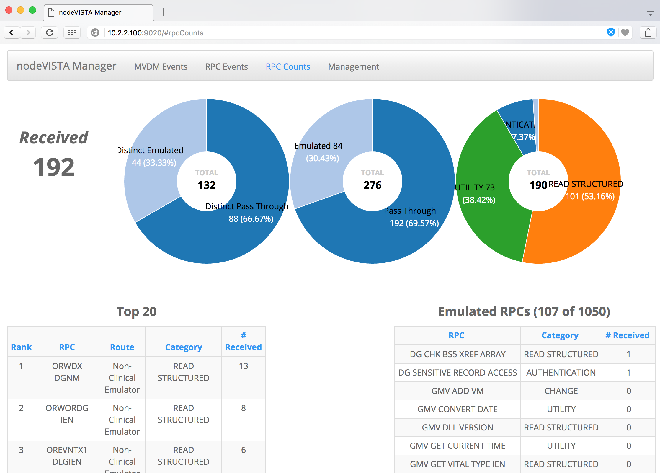
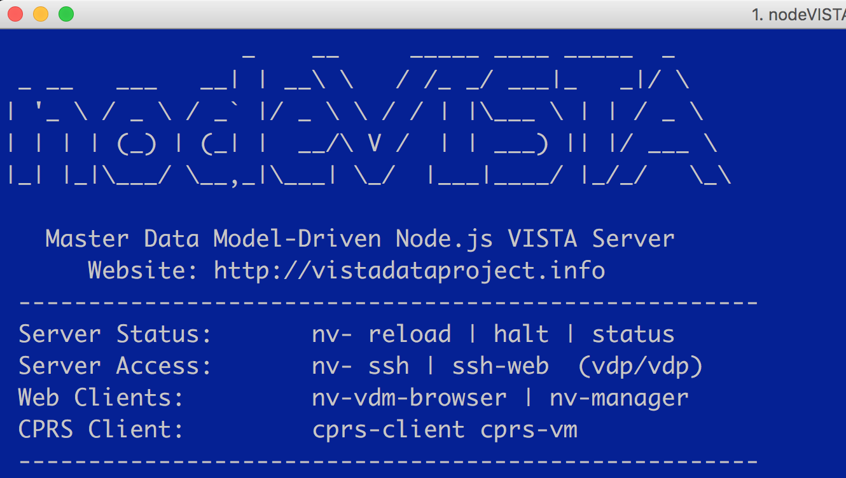
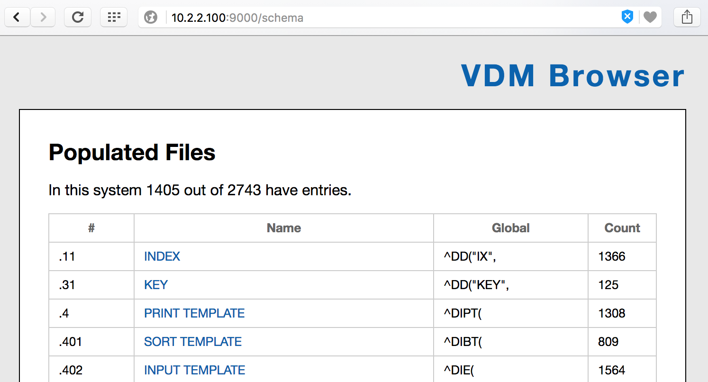
nodeVISTA Implementation
New Server. Clients both old and new.
CPRS client
Audit client
CPRS
JLV
…
web
mobile
…
Emulator
Event listener
VDM Browser
Emulators
REST
Clinical Services
Node
Master VDM
VISTA Data Model (VDM)
VA Fileman Database
nodeVISTA
-
10￼
-

Slide 11
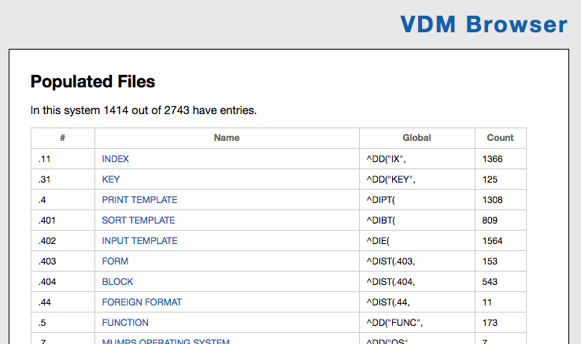
VDM Browser
Demonstrates that VDM Exposes ALL FileMan-stored data (including labs)
-
11￼
-

Slide 12
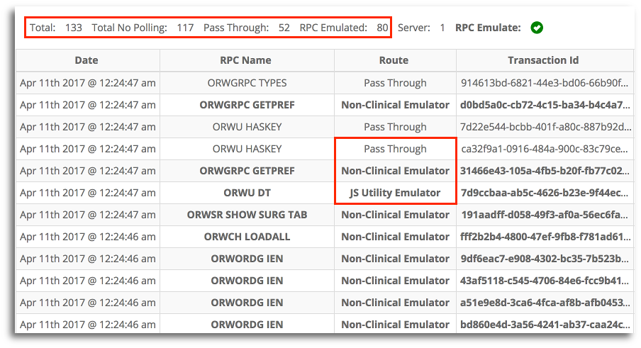
RPC Traffic Audited
Chatty CPRS and how RPCs are handled
-
12￼
-

Slide 13
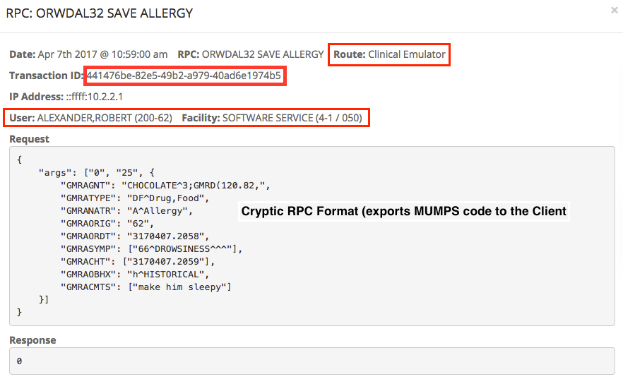
RPC Details Tracked
All RPCs traced by user, facility, emulation type, and transaction ID
Cryptic RPC data payload
(Sends raw MUMPS code to the Client!)
-
13￼
-

Slide 14
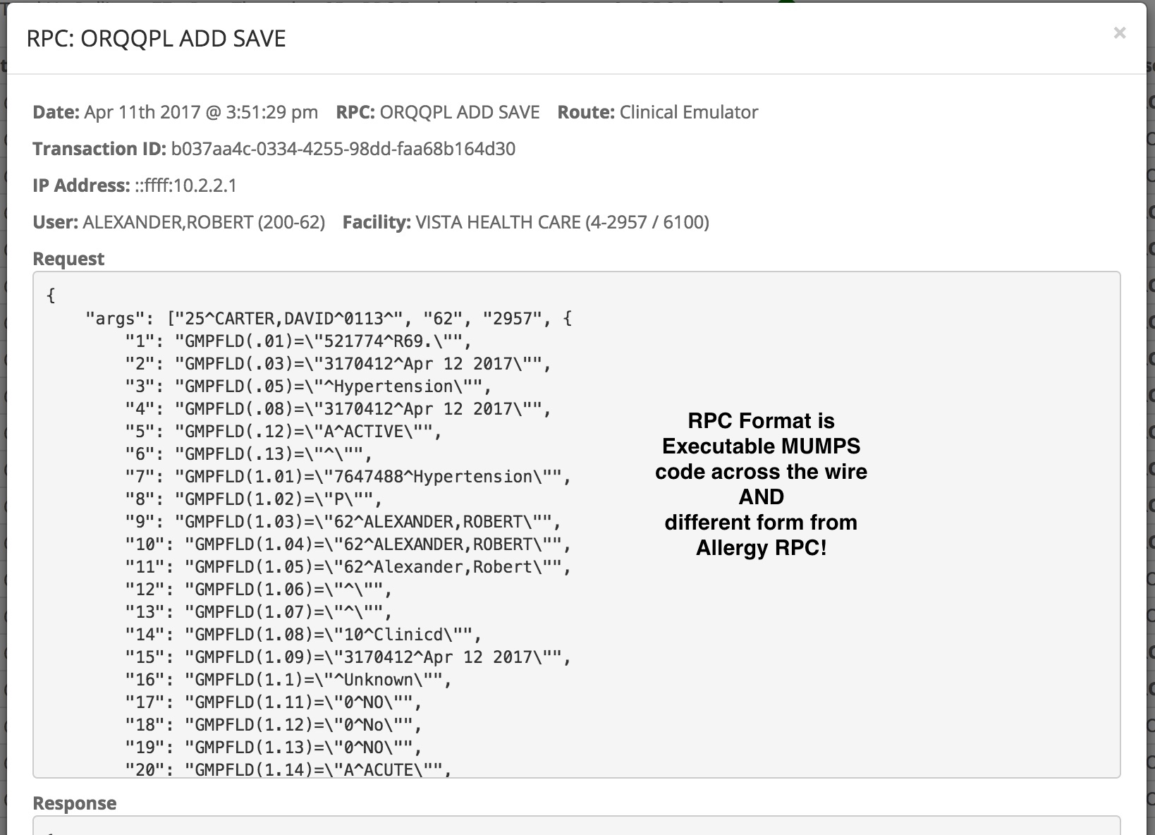
RPC Detail - Problems
This is a dangerous RPC
MUMPS RPC data is:
Insecure - Sending raw MUMPS code across the wire permits code execution (i.e. code injection).
Inconsistent, Opaque - A different, ad-hoc, undefined format and form for each RPC (x1000’s).
Unmanageable (and risky!) for new clients to consume
-
14￼
-

Slide 15
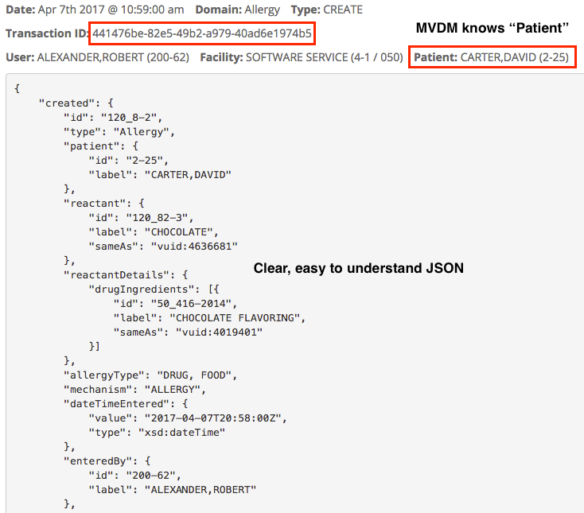
MVDM from Emulated RPC
RPC emulation leads to MVDM activity: Patient-aware and Easy to Understand
same transaction ID as RPC, but..
MVDM knows “Patient”
Required if one desires patient-centric access control
MVDM data is:
Clear, well-defined
Easy to understand
Web-standard JSON
It is essential to understand the data before one is able to provide or control access to it. MVDM provides such structure and definition.
-
15￼
-
Notes:
It is essential to understand your data before you can control access to your data.

Slide 16
Summary
VISTA Data Project
We have proven that one can guarantee continuity of care while migrating to a modernized EHR.
A modernized EHR could be a
Refreshed VISTA and/or
A collection of COTS applications
Emulation can work over both.
CPRS / JLV
(current continue)
web/mobile
(new enabled)
Secure
Symmetric
Modern Node.js
Model-driven
Interface
or
RPC Emulator
VPR Emulator
REST
Clinical Domain Services
node
VISTA
Master VISTA Data Model
Node
VISTA Data Model
VA Fileman Database
New, Structured VISTA Server
(mainstream, modular, extensible)
https://vistadataproject.info

